Slide 1

Ripe Pumpkins ‘Pumpkinmeter’ can revolutionize movie recommendation experience.

Slide 2
Introduction- Why Leveraging Pumpkinmeter Score Insights Drives Customer Loyalty and Competitive Advantage?
You all are here because we know the importance of movie reviews and recommendations in today's digital age.
We will assess the initiative's potential and its implications for Ripe Pumpkins' future success in the next slides
Is there market potential?
What features of Pumpkinmeter makes it achievable and sustainable?
Is Pumpkinmeter providing accurate recommendations?
User 1 watchlist and recommendations results
User 2 watchlist and recommendations results
Insights
Foresights

Slide 3
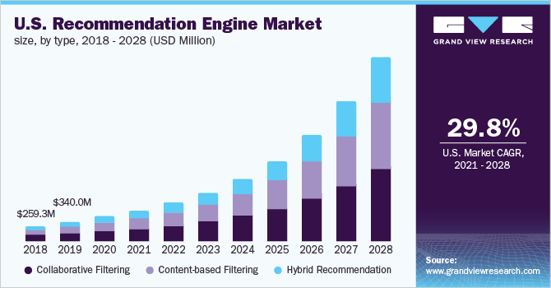
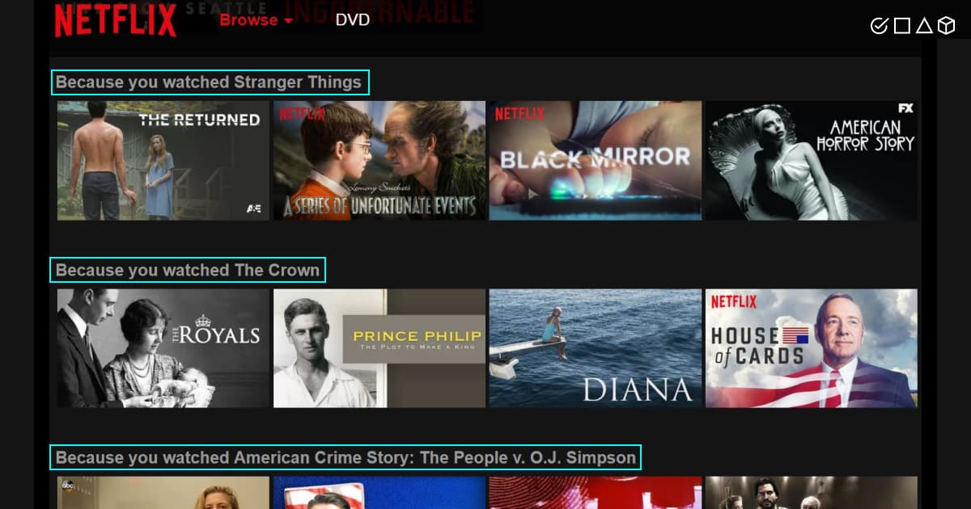
Is there market potential?
According to a new report by Grand View Research, Inc.
The global recommendation engine market size is expected to reach USD 17.30 billion by 2028,
The market is expected to expand at a CAGR of 33.0% from 2021 to 2028.
Recommendation engine is being used everywhere starting from retail, music applications, video platforms, movie.

Slide 4
What features of Pumpkinmeter makes it achievable and sustainable?
Recommender systems encompass techniques and algorithms for suggesting relevant items to users.
Personalized recommendations are based on user preferences and viewing history.
Improved search functionality.
Pumpkinmeter utilizes User-based Collaborative Filtering as its recommendation system.
Low costs due to the use of Spark technology for model training and reusability.
Include relevant data and metrics to showcase the impact on customer behavior and feedback.
Scalable for handling large volumes of movie data and user preferences
Continuous learning and adaptation based on user feedback
Flexible recommendation filtering using factors like genre and timestamp
Integration of user feedback for refining recommendations
Sustainable design with regular updates and maintenance

Slide 5
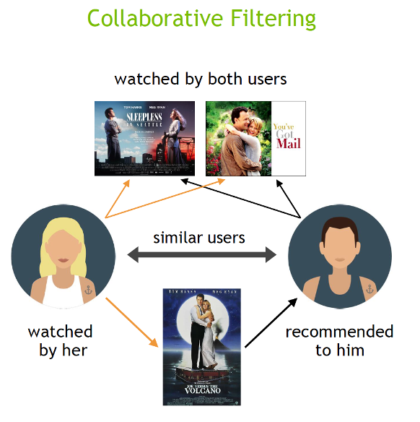
Is Pumpkinmeter providing accurate recommendations?
Dataset: GroupLens MovieLens Dataset
Tested with movie and review list based on liking and interests of two different users.
Algorithm used: Alternating Least Squares
Trained on dataset with 27,000,000 ratings and 1,100,000 tag applications. Includes tag genome data with 14 million relevance scores across 1,100 tags
Testing for top 15 recommendations with more than 25 and more than 100 reviews
Results:
Achieved low average prediction error i.e. more accurate recommendations
Recommendations tailored to each user's interests.
Predicted rating for a particular movie for a given user.
Better recommendations observed for movies with more than 100 reviews
Pumpkinmeter is using collaborative recommendation, also known as collaborative filtering, involves predicting user interests by gathering preferences or taste information from a group of users.

Slide 6
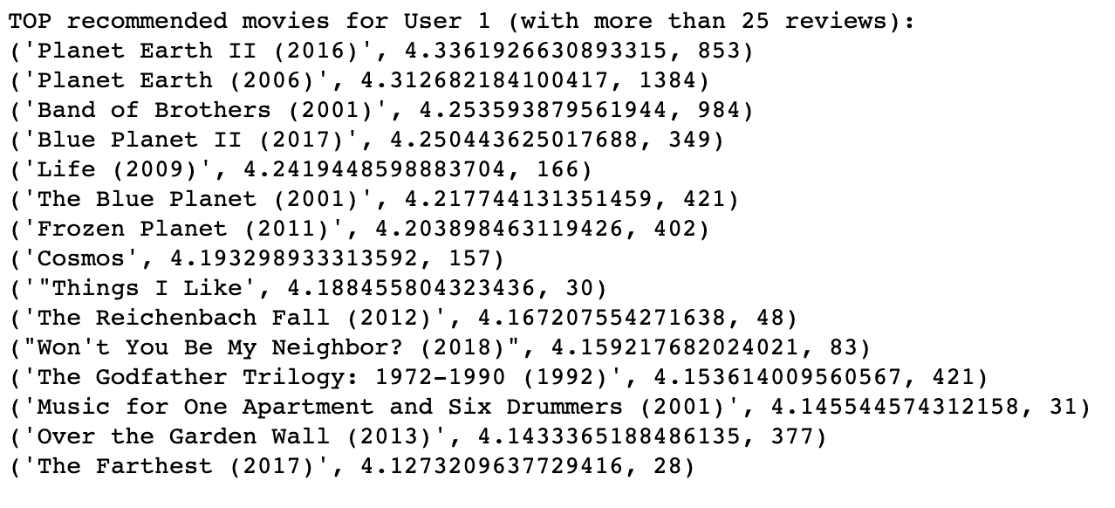
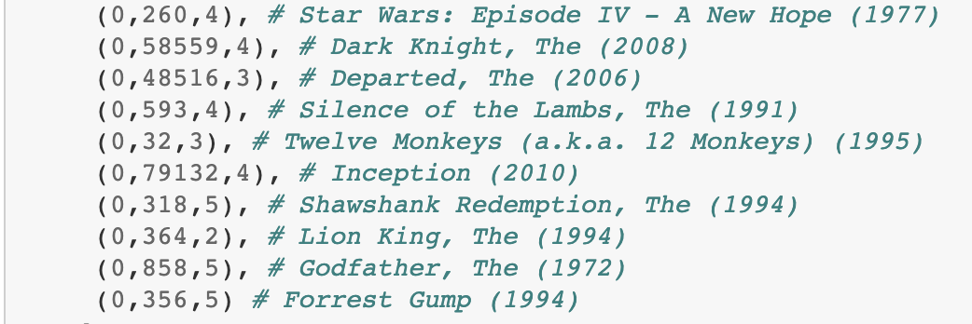
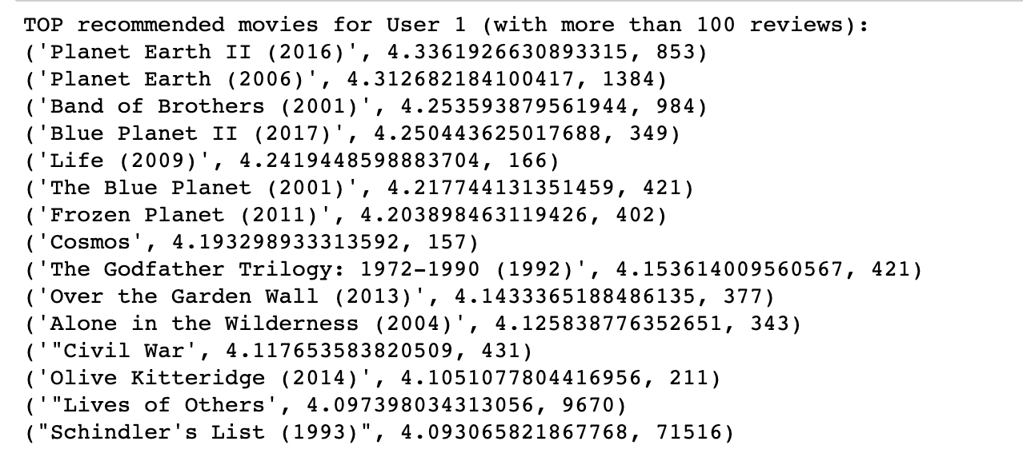
User 1 watchlist and recommendations results
Recommendations (movie-name, ratings, reviews) by Pumpkinmeter are mostly aligned to genres rated best by user.
Reviewed 10 movies watched by User1 in the past. Movies genres listed are crime, drama, mystery, scifi, thriller and one for anime, adventure, romance.

Slide 7
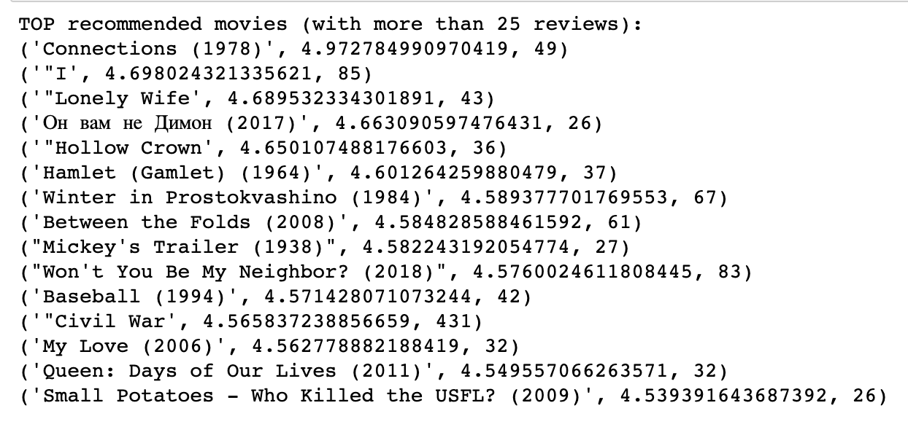
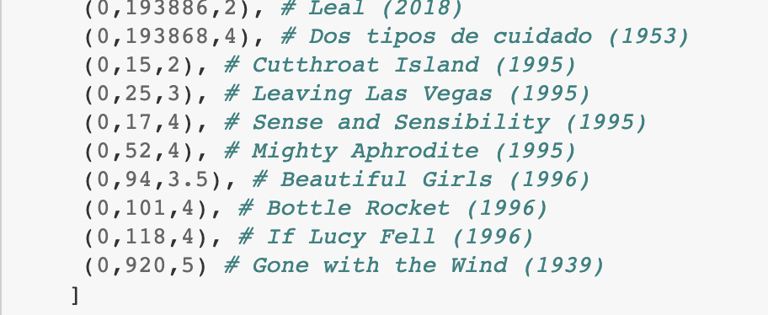
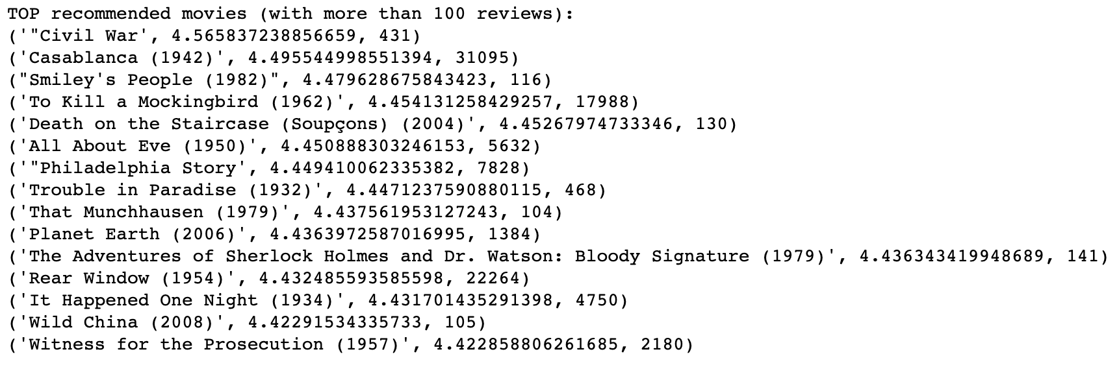
User 2 watchlist and recommendations results
Recommendations (movie-name, ratings, reviews) by Pumpkinmeter are mostly aligned to genres rated best by user.
Reviewed 10 movies watched by User2 in the past. Movies genres listed are romance, comedy, drama, and few for action, crime, adventure, war.

Slide 8

Insights
Through the results of Pumpkinmeter we can get below insights:
Deep insights into user preferences based on movie ratings
Tailored movie recommendations through Pumpkinmeter score
Can enhance retention rates with personalized recommendations
Improved performance for popular movies (>100 reviews)
Provides valuable insights for business decisions: trending genres, user preferences, content optimization

Slide 9
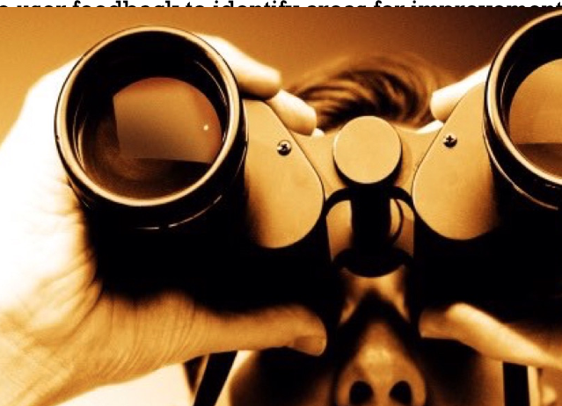
Foresights
The implementation of the recommendation engine highlights opportunities for ongoing model refinement and algorithm enhancement to further enhance recommendation accuracy and user satisfaction.
Tune filtering algorithm with diverse user data for improved accuracy
Incorporate genre and timestamp as factors for enhanced recommendation accuracy
Encourage user ratings and feedback to refine the recommendation system
Collect and analyze user feedback to identify areas for improvement
Possibility of persisting the RDDs of model for future use to save time
Adapt the model for web environments to provide online movie recommendations

Slide 10
References
Grand View Research. (2021, September 16). Recommendation Engine Market Size Worth $17.30 Billion by 2028 | Grand View Research, Inc. PR Newswire. Retrieved from https://www.prnewswire.com/news-releases/recommendation-engine-market-size-worth-17-30-billion-by-2028-grand-view-research-inc-301378305.html
Quantzig. (n.d.). Recommended: Data Analytics & Movie Recommendation Engine. Retrieved from https://www.quantzig.com/blog/recommended-data-analytics-movie-recommendation-engine/
Shrivastava, A. (2020, Oct 02). How to Build a Movie Recommendation System. Towards Data Science. Retrieved from https://towardsdatascience.com/how-to-build-a-movie-recommendation-system-67e321339109
Kniazieva, Y. (2022, April 14). Guide to movie recommendation systems using machine learning. High quality data annotation for Machine Learning. https://labelyourdata.com/articles/movie-recommendation-with-machine-learning
J. A. (2015, September 14). Building a Recommender with Apache Spark & Python: Example App & Part 1. Codementor. Retrieved from https://www.codementor.io/@jadianes/building-a-recommender-with-apache-spark-python-example-app-part1-du1083qbw

